Slide 1
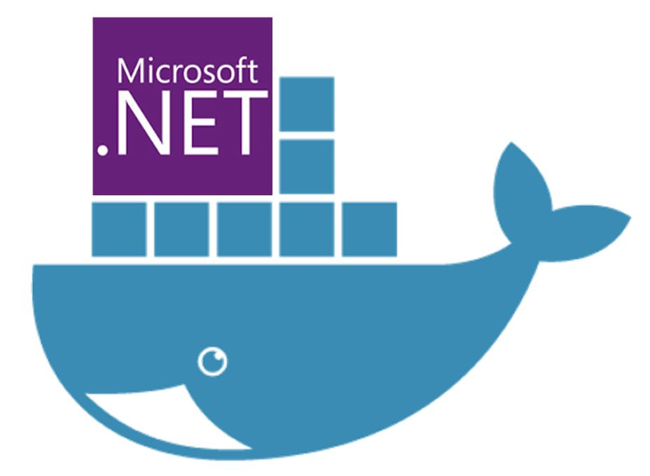
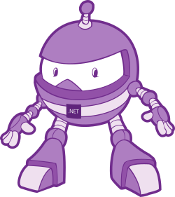
Dockerising .Net applications
Simplifying software delivery for .Net Devs (even if your boss says you can’t use Docker!)
Slides & code available on Github: https://bit.ly/2EO2lth (case sensitive!)

Slide 2

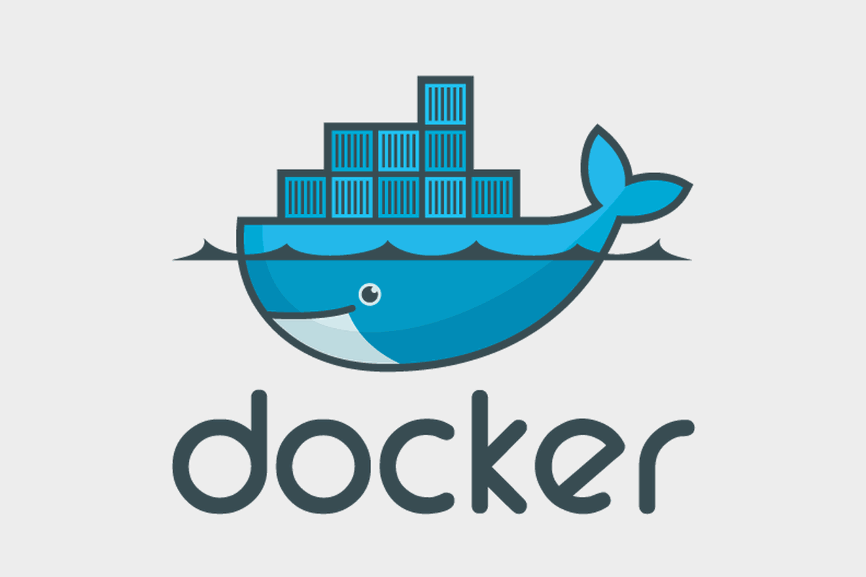
What is Docker?

Slide 3
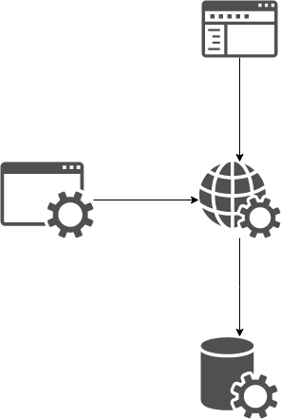
Context: Our Application Stack
Web
Front end
Web
API
Automated
Tests
Database

Slide 4


Setting up you Dev Environment
==

Slide 5
Demo 1

Slide 6
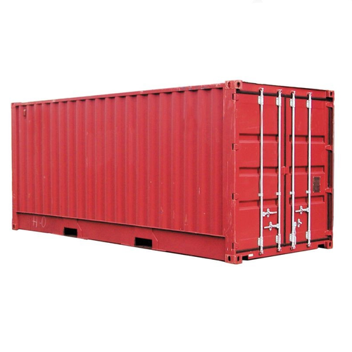

Same Stack, but running in containers

Slide 7
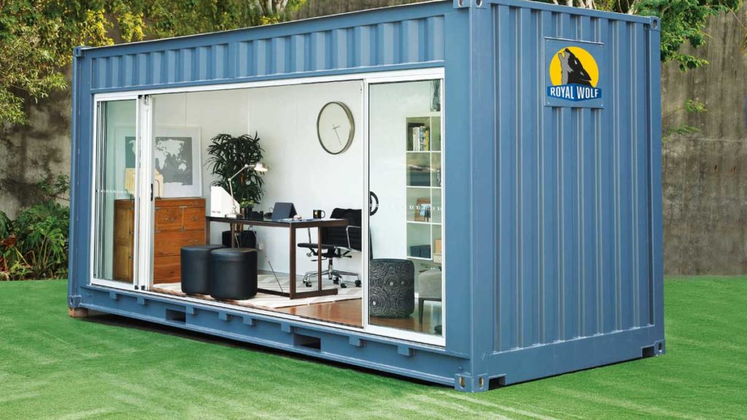
Use cases for Docker

Slide 8

QA / Testers

Slide 9

UI Devs

Slide 10

Devs

Slide 11
What using Docker in your Dev process gives you

Slide 12
Context Switching
Application Y:
MVC
Web API
SQL Server
Application X:
React
Node.js
Mongo

Slide 13
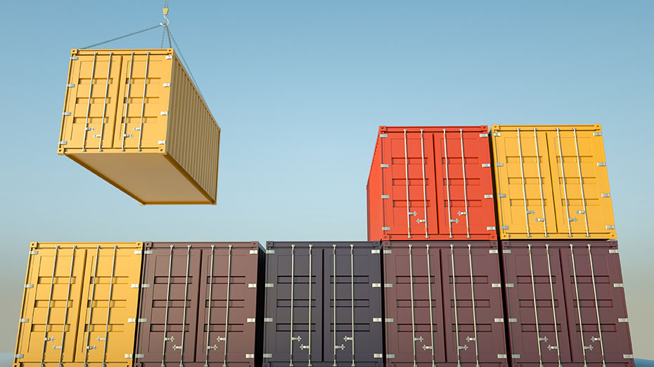
Introducing Containers!

Slide 14
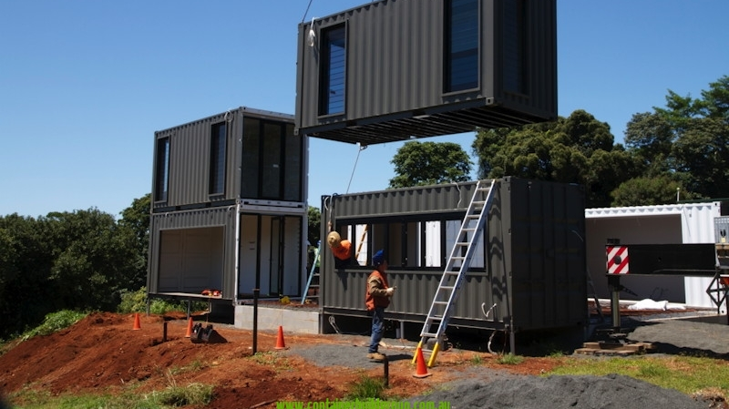
Building Containers
Containers are created from Images
Images describe your application, like blue-prints
Images are created using a Dockerfile
Notes:
Ok, so we now know what Docker is and have an idea of what it can do for us once we have our apps in Containers.
Now we need to know how to get our app inside a container?
You spin up a Container instance from an Image. (note the language I used there - spin up a Container Instance or Instances, from an image)
A Container is a runtime instance of an image, and you can have many instances, for example, in a load balanced environment.
An image is an executable package that includes everything needed to run an application-
You define an image using a Dockerfile, which contains all the instructions for creating your image.
Its essentially the blue prints for what every Container instance created from it will look like and behave.

Slide 15
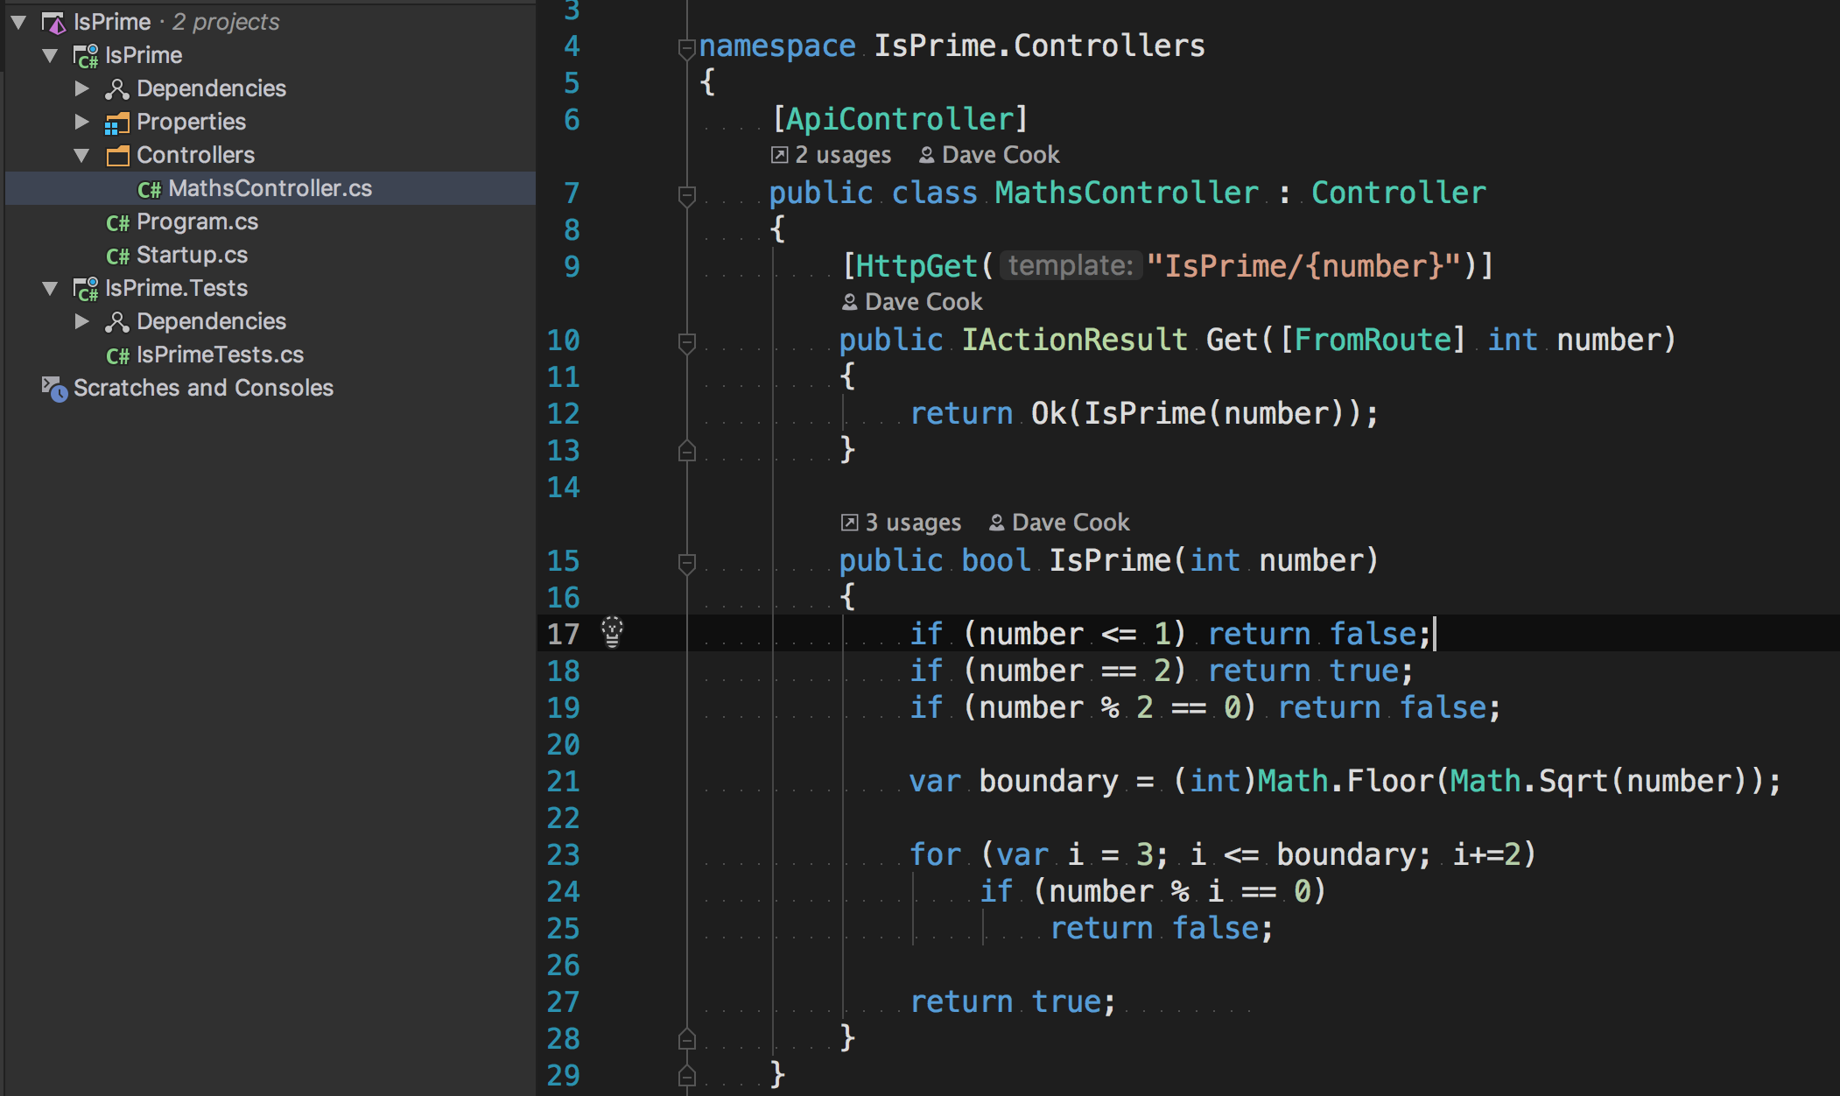
Context: Our Sample service
Notes:
In a moment we will have a look at our first DockerFile
But before that, let me first introduce the application that we are going to be Dockerising: A really simple web api project, running on .Net Core.
This provides a single HTTP endpoint to make a get request, and returns a response indicating if the supplied parameter is a prime number or not.
On the left you can see the solution structure – there is a single project folder called IsPrime which contains the WebApi service, and a single test project called IsPrime.Tests, with a few tests to run over the code on the right.
The code in the service is super simple - I’ve omitted things like error handling and Dependency injection for clarity.
Something you can’t see here is that this service is configured in Program.cs to run on Port 9021

Slide 16
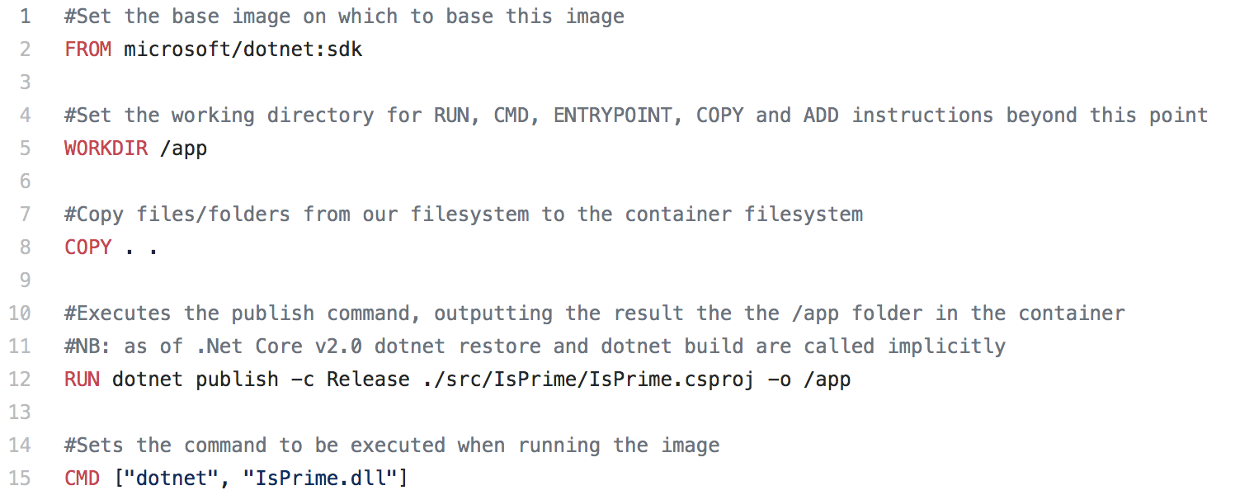
Dockerfile_v1 - Over simplified
Notes:
Here is our first, deliberately very simple dockerfile.
There is a lot of stuff to explain here, so we’ll walk through it together.
There are 6 instructions in this Dockerfile, which all run in the order specified.
The FROM instruction (which is almost always the first instruction in every Dockerfile) specifies the base image that this image builds upon and the operating system your image will be based upon
In this example, we are using the latest version of the .Net Core SDK on Linux (although that’s not particularly obvious – you’ll see that the Windows images have the word Windows in the image name.)
Images work in a similar way to large inheritance hierarchies in .Net – with each new Layer adding more behavior on top of the previous.
So here we are using building on top of a Dotnet SKD layer, which is build upon a Linux Layer, all the way to the root image which is built in something called Scratch.
The base image will be hosted in a Docker Repository of some description – I’ll discuss that further later, but the default public Docker Repository is DockerHub.
The WORKDIR instruction sets the working directory where all subsequent instructions in the Dockerfile will apply.
The COPY instruction copies all of our source files to the file system of the image.
The RUN instruction executes the dotnet publish command within the image. In this example, this outputs the generated dlls to the App folder, which is also our current working directory.
The CMD instruction defaults what is executed when the Container is started - and this is the dll we have just generated via the publish command.
In essence, this Dockerfile builds a new image on top to the Linux .Net SDK image, copies our code onto the image, creates a DLL buy calling .Net Publish, and sets this Dll as the process to run when the container starts.
Our first Dockerfile is ready, and we could now build an image from this and spin up a Container from it.
However, there are a few issues that we really ought to resolve first!
docker build -t isprimedotnetcore .
docker run -p 9021:9021 isprimedotnetcore

Slide 17
Demo 2

Slide 18
Dockerfile_v1 - Issues
Notes:
What’s wrong with this then?
A number of things!
It doesn’t run any of the tests from the solution, so we could be generating an image to load up a service that compiles ok, but actually doesn’t behave quite how we expect it to.
Our image is based on the .Net Core SDK, rather than the runtime. We don’t want to use the SDK in production: the SDK is much bigger than the runtime, so takes longer to download, and obviously has a much larger attack vector and opportunities for misuse. Just like how we’d never install the full SDK of the .Net Framework on a production server, we don’t want to use it in Docker either.
The copy instruction copies WAY too many files to the the Container – it’s copied literally everything from the root of our project to the image, so again, increasing the size of the image, and therefore the time to download it.
It’s not deterministic – because we have not explicitly specified a version tag, Docker is defaulting to a tag called Latest. There are many ways in which this can come back to haunt us, because Latest doesn’t necessarily mean latest as you would expect, and as a result this can result in building your image on a complexly different version to what you actually wanted, which means that you can run the same command twice and end up with different results.
So lets improve upon our first attempt a little, starting with repeatable builds.

Slide 19
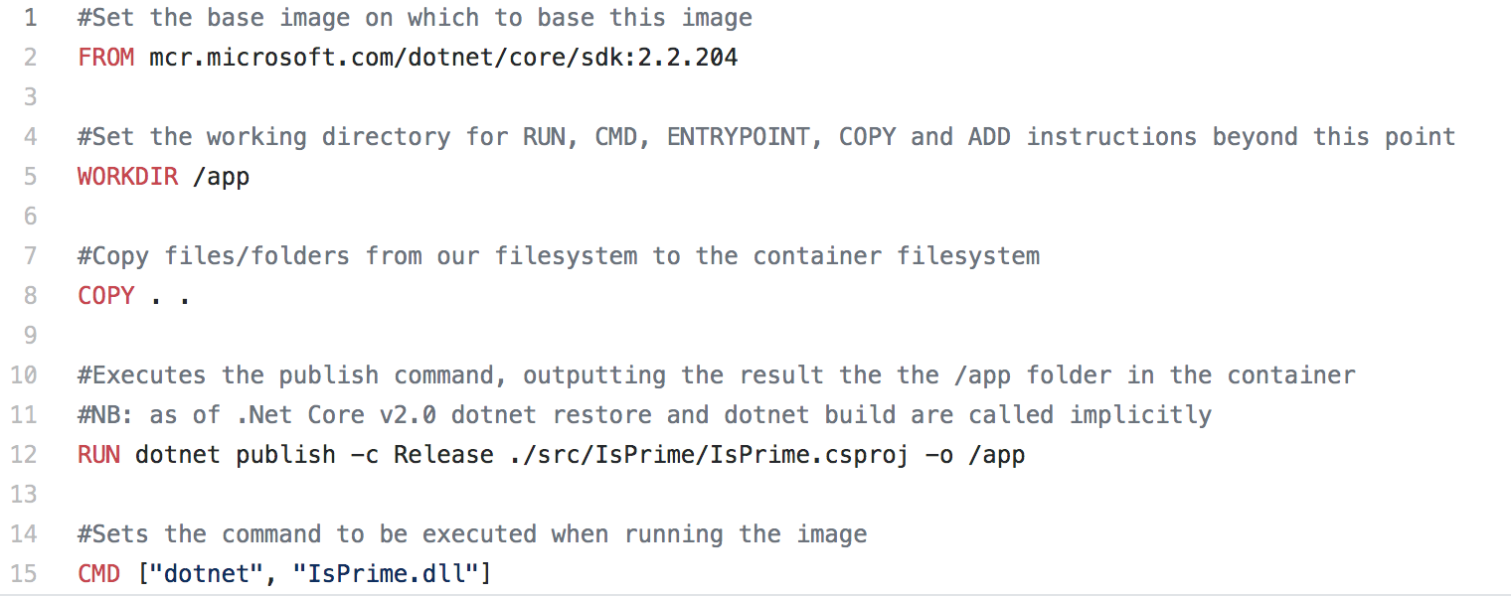
Dockerfile_v2 - Deterministic
Notes:
In this version of our Dockerfile we’ve updated our FROM instruction to use a version Tag to specify a fully qualified semantic version number – in this example, v2.2.204.
This means that whenever and where ever we build an image from, we’ll always be using 2.2.204.
The same Docker image will be generated whenever we rebuild it, which means my continerised Service will behave the same, because my build artefacts haven’t mysteriously changed between builds.
Yeh!
Now the observant amongst you may have noticed that this from statement contains more differences than just a version number.
It still requests the .Net Core SDK, and it’s still a Linix image (although again, that isn’t obvious).
But this time it’s prefixed with mcr.microsoft.com…
This is because I am now pulling my base image not from DockerHub as in the previous example, but from Microsoft’s own container registry (MCR for short).
MS no longer host patch versions of their images on Dockerhub, only on MCR, so if you want to be this specific about your image versions as this, then you need to get your images from there instead.
In fact, it’s probably best to pull your images from the MCR even if you are not being specific about versions numbers, because Dockerhub redirects to MCR anyway, so it should be a little quicker.
I’ve include a link explaining the reasons behind this on the resources slide at the end.

Slide 20
Demo 3

Slide 21
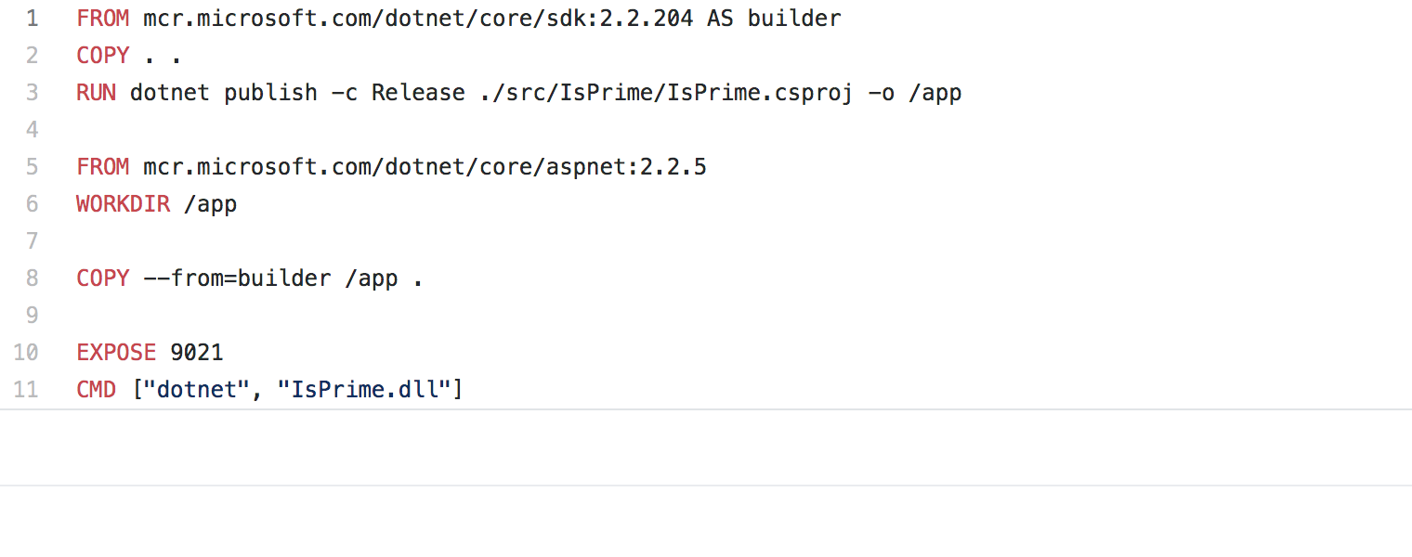
Dockerfile_v3 – Multi Stage Dockerfile
Notes:
In this version of our Dockerfile, we address the issue of using the SDK in our production environment by using a Multistage Dockerfile.
A Multistage DockerFile contains multiple FROM instructions, with each FROM instruction creating a new stage.
You can selectively copy artifacts from one stage to another, leaving behind everything you don’t want in the final image.
This example contains 2 stages.
The first stage executes a FROM instruction using the SDK that we used previously to create an image,
The second stage, which starts on line 5 with the second FROM instruction, specifies the base image to create a new image based on the .Net Core ASP Net runtime (Note that we are using a Tag to request a
Specific version of the runtime image in order to get deterministic builds)
Then on line 8 we copy the contents of the app folder from the first stage to the final image that we will use as our build artefact.
It does this using the Name we gave to the first stage at the end of line 1.
Everything works exactly the same as it did before, but this time, our final image that we will create Containers from is built on top of the smaller, less vulnerable Runtime image.
Do another quick demo to show that everything still works.

Slide 22
Demo 4

Slide 23
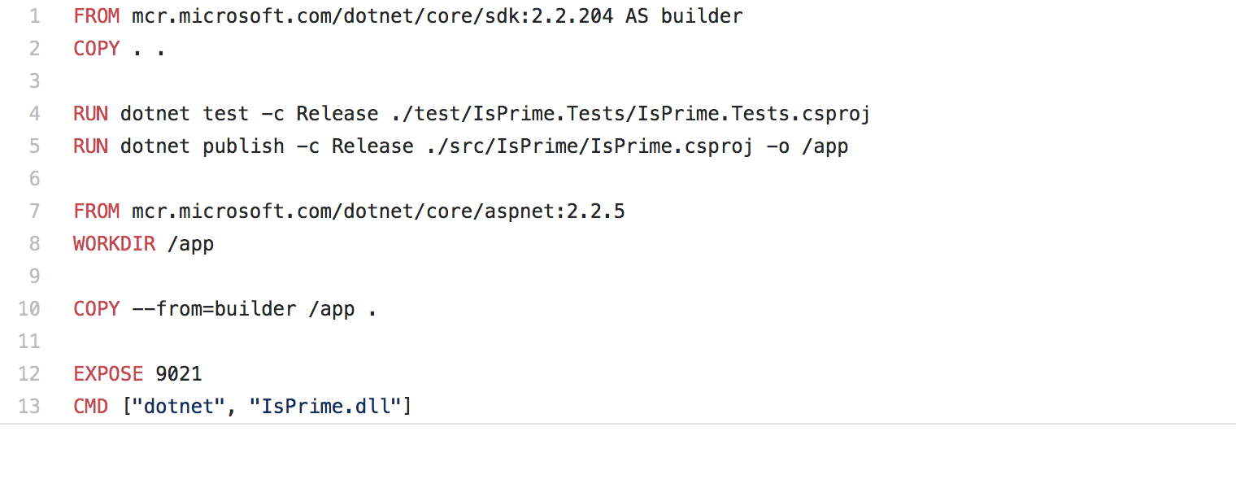
Dockerfile_v4 – run the Tests
Notes:
In this version of our DockerFile we want to ensure that we only generate build artefacts if our service is actually behaving the way we expect, ie it meets the specification
In order to do this, we need to run the tests from with our Test Project.
In order to run our tests we need to use the SDK to run the dotnet test command (an operation we cant run using the runtime).
On line 4 we now execute Dotnet test against the test project that has already been copied to our builder stage.
At this point, if any of the tests in that test project fail for any reason, the rest of the build will stop and exit with an error code. (Check this is all correct)
Again – quick demo to show everything still works (Failure Demo??)

Slide 24
Demo 5

Slide 25
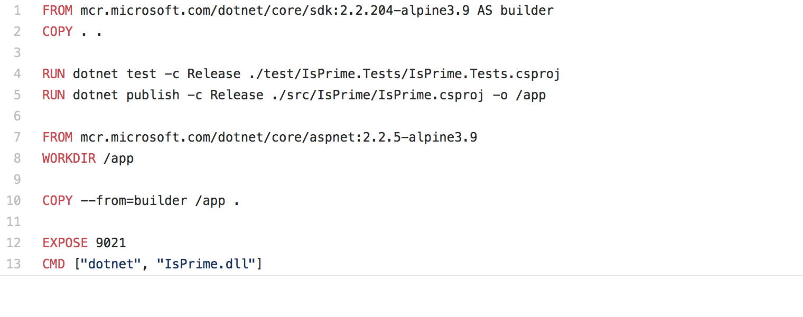
Dockerfile_v5 – smaller images FTW!
Notes:
In our final revision of our Dockerfile, we have made a very minor adjustment to the base images that well use in our Multistage build process.
At the end of lines 1 and 7 you will see that the image Tags now include an Alpine version.
This change is aimed at reducing the size of our images so that they build faster, and so that we can push and pull them from our container registry faster.
This is because Alpine is a very light weight version of the Unix operating system. Other choices include Debian & Ubuntu.
Lets have another quick demo to check things still work, and have a look at how much we’ve brought down the image size with all these improvements.

Slide 26
Demo 6
Notes:
docker images isprime_dotnetcore

Slide 27
Build an Image, start a Container
docker build -t isprime_dotnetcore:1 -f ./Dockerfile_Iterations/v1/Dockerfile .
docker run -p 9021:9021 isprime_dotnetcore:1
docker build -t isprime_dotnetcore:1 .
docker run -p 9021:9021 isprime_dotnetcore:1

Slide 28
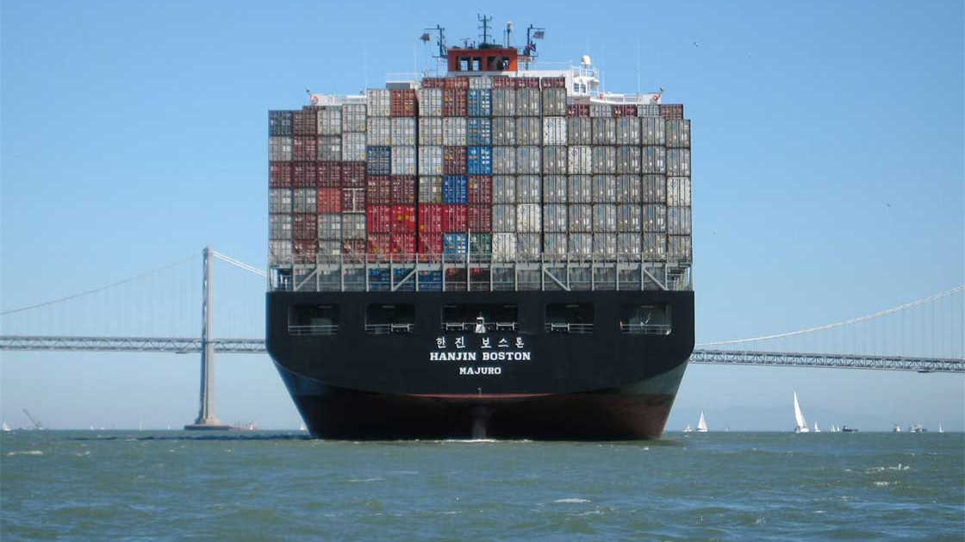
Docker Compose

Slide 29
Other stuff I couldn’t fit in
Security – which user are you running as?
dockerIgnore files – exclude files from your build context to keep images smaller

Slide 30
Resources
https://andrewlock.net/exploring-the-net-core-2-1-docker-files-dotnet-runtime-vs-aspnetcore-runtime-vs-sdk/
https://andrewlock.net/caching-docker-layers-on-serverless-build-hosts-with-multi-stage-builds---target,-and---cache-from/
https://www.stevejgordon.co.uk/docker-dotnet-developers-part-1
https://devblogs.microsoft.com/dotnet/net-core-container-images-now-published-to-microsoft-container-registry/
https://docs.docker.com/engine/examples/dotnetcore/
https://medium.com/@gdiener/how-to-build-a-smaller-docker-image-76779e18d48a
https://training.play-with-docker.com/
https://docs.docker.com/
https://hub.docker.com/_/microsoft-dotnet-core
https://hub.docker.com/_/microsoft-dotnet-framework/

Slide 31



Questions?
https://medium.com/@dcook_net
@dcook_net
https://github.com/dcook-net/

Slide 32
What can Docker give me and my team, right now?
Control
Speed
Repeatability
Notes:
Never mind all the sale pitch, and dev ops bla bla.
What problems does it solve for a team of people trying to deliver software, regardless of whether they have permission to use Docker in production?
Works on my machine
New team members up and running quick – no more installation and setup guides that takes days: just pull the repo and run!
Less technical team members up and running quick, with no detailed knowledge how the software all hangs together
Infrastructure as code
Maintainable, reproducible build and test process
Means that context switching between applications is much less painful
Language agnostic
Tech agnostic
OS agnostic
Fast
Need to explain all this!

Slide 33
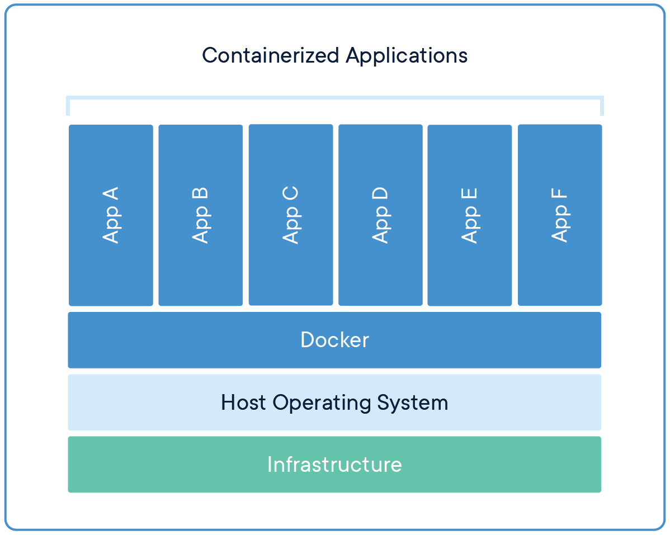
What is a Container?
With Docker, you can just grab a portable Python runtime as an image, no installation necessary. Then, your build can include the base Python image right alongside your app code, ensuring that your app, its dependencies, and the runtime, all travel together.
These portable images are defined by something called a Dockerfile.
Light weight wrapper around a process, that runs on top of the Host and shares its resources.
Contains all the dependencies you app requires: code, runtime, dependent dlls, config, even the OS
Will run anywhere that Docker is installed
Notes:
Docker containers wrap up software and its dependencies into a single software artefact that includes everything it needs to run: code, runtime, operating system and libraries – all of it’s dependencies!
A container is basically a single, portable package containing an application, that guarantees that application will always run everywhere.
To run your applications in new environments or developer workstations, you simply need to run the container in that environment – you don’t even need to have any of the required tech installed on the target machine (except Docker).
Example:
So if I build a .Net Core web api to expose functionality you need and you want to run it on your local machine, you can simply pull the code from Github, build and run the container, and then start hitting the api from your app, or postman. You don’t need to worry about what version of .Net it runs on, you don’t even need .Net installed on your machine, you just need Docker.
You don’t even need to worry about what operating system it needs, you just need Docker.

Slide 34
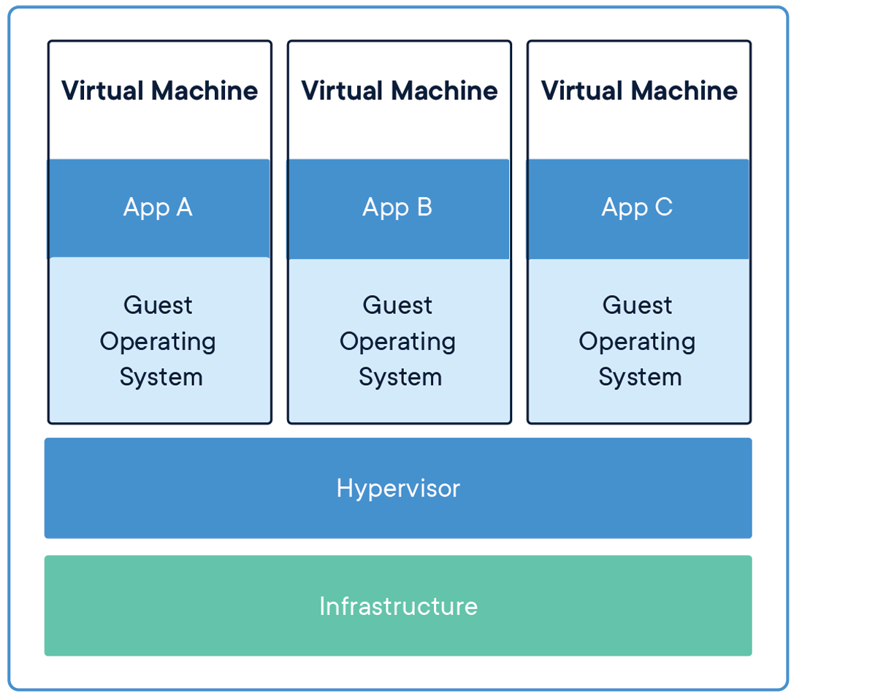
Containers are not VMs!
VM
Contain a complete OS
Long lived by nature
Persistent State?
Complete Isolation from other VMs
Docker Containers
Layered on top of the Host
Ephemeral in nature
Stateless?
Limited Isolation
Notes:
Containers are often described as or compared to Virtual Machines, but this is a poor comparison.
Containers are thin layers that are applied on top of an operating system, where as VMs contain the operating system they are standing in for.
Both models share the resources of the Host, but Containers are more light weight than VMs, and therefore faster to spin up and tear down.
VM’s are built to mimic a physical server, and although can be spun up and town down on demand, the lifespan of a VM is typically measured in days or months, where as a container may live for only a minute of so before being destroyed, or could stay running for long periods too.

Slide 35
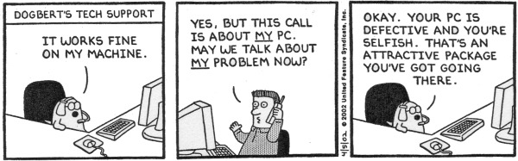
Why use Docker?
Fast, and reduces manual setup tasks, making the team go faster
Sort after skills, can be applied to any OS or programming language
“Works in my Container!” == “Well I guess it just flippin’ well works then!”
Notes:
It’s fast, in many aspects:
spinning up a container can take as little as a few seconds, especially Unix containers which are mush faster than Windows containers
new devs on the team can be setup in minutes instead of hours, days or weeks, so they can start delivering value faster
Massively reduces the burden of keeping software running on less technical team members development environments
Enables automation, and therefore reduces human error and speeds up delivery.
Its also a highly sort after skillset – industry standard – stack overflow (Expand a little)
OS & Language agnostic – so it fits well with polyglot development
Everything just works ‘out the box’ solves the age old headache of environment setup and configuration of new environments and workstations, so gone are the days of ”Works on my machine!”
And, as already stated, puts you in control of infrastructure – you’ll see exactly how and why that is soon.

Slide 36
Quick Demo
docker pull mcr.microsoft.com/dotnet/core/samples
docker run -it --rm -p 8000:80 --name aspnetcore_sample mcr.microsoft.com/dotnet/core/samples:aspnetapp
http://localhost:8000
Notes:
Quick demo to pull a dotnet image from docker hub, build a run, then browse to the site.

Slide 37
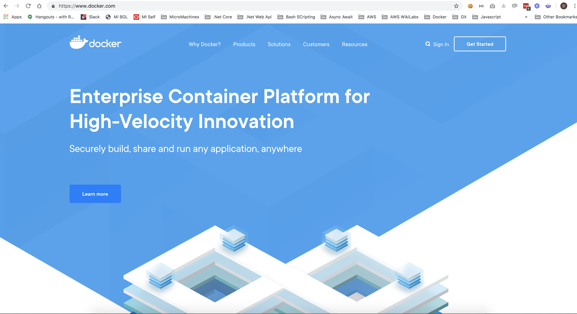
What is Docker? What does it do? The shpeel….
Standardises & Simplifies software packaging and delivery
Gives control of infrastructure and dependencies to Developers
Enables Deployment teams to focus on deployment, rather than installation
Notes:
High level …. Docker is a very simple tool for building and sharing our software with others.
You’ll see in the coming demos that it:
standardises how we build and interact with our applications, making them technology agnostic from the outside.
enables Dev teams to focus on delivering working software, while also giving them more control over the infrastructure in which that software runs: for example, if you want your service to run on version 3 of .Net Core then you are in control of that, not the Release Team, and you don’t need to worry if that dependency will be installed in production when it comes to going live.
Enables Ops teams of focus on deploying software to various environment without getting bogged down in technical details of provisioning environments, for example; version A requires version 3 of dependency B. This means that they can focus on improving the deployment process.
All of this creates a clear handover point between dev and ops, and means there is a lot less wasted time going back and forth between these teams.
That sounds great – How does it do that?

